Slide 1
Data Science & March Madness
Matt Jones

Slide 2

What is the NCAA Tournament?

Slide 3

What is the NCAA Tournament?
The National Collegiate Athletic Association (NCAA) is a governing body for intercollegiate sports
There are 351 Division I basketball schools
At the end of the regular season 68 of these teams participate in a single elimination tournament
The winner of this tournament is declared the National Champion for that season

Slide 4
Filling the Bracket
32 teams automatically qualify by winning their conference championship
The remaining teams are chosen by a 10 person selection committee. It consists of school athletic directors and conference commissioners from each part of the country
After the teams are selected, the committee assembles an S curve ranking the teams 1 through 68. These positions are used to slot each team into the bracket so the regions are balanced.

Slide 5
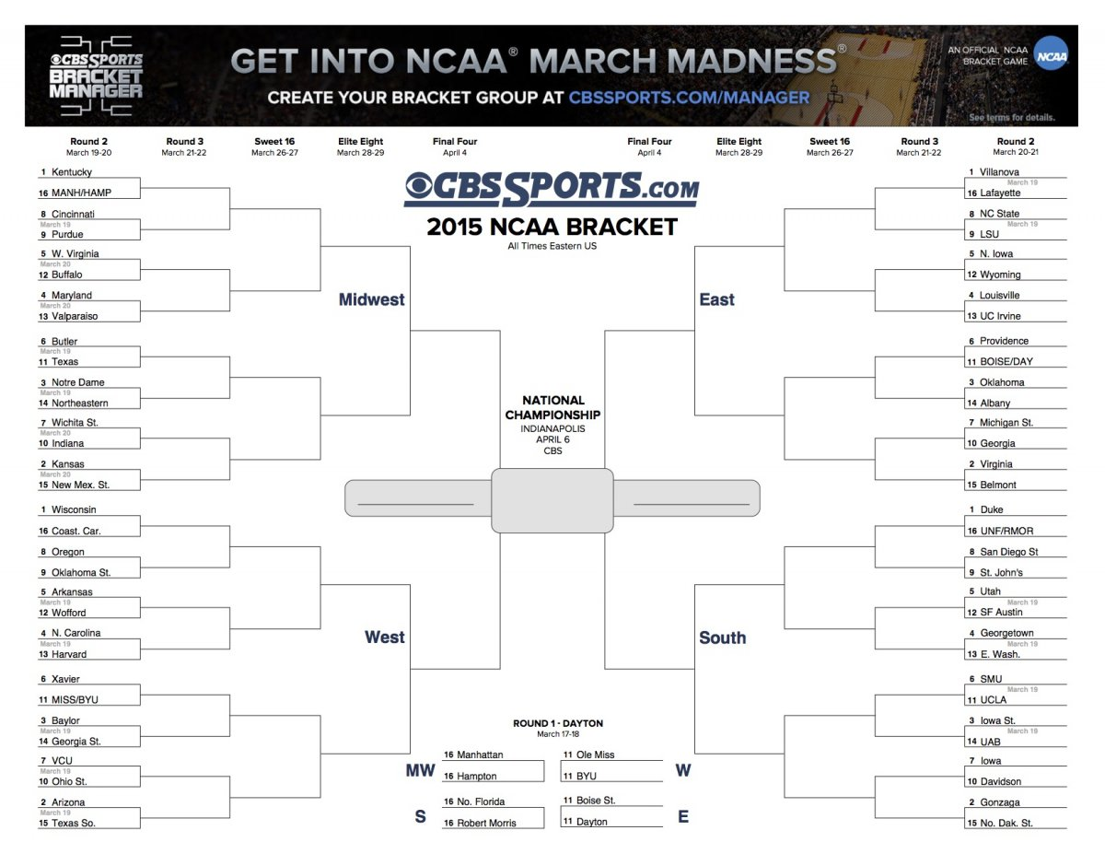

Slide 6
Selection Metrics – Top 25 Polls
AP Poll
Weekly ranking from the Associated Press
65 sports writers from across the country rank teams 1 through 25
Ranks are assigned points (#1 rank = 25 points, #2 = 24, etc…)
Points are aggregated to form the top 25 teams
Rankings are generally based on a teams record, the conference they play in, and the “eye test”
Coaches Poll
Weekly ranking from NCAA Division I coaches (or athletic directors)
32 coaches/athletic directors follow the same process above

Slide 7
Selection Metrics - RPI
The Rating Percentage Index (RPI) has been used by the NCAA men's selection committee since 1981
RPI = (WP * 0.25) + (OWP * 0.50) + (OOWP * 0.25)
Home Games: Win = 0.6, Loss = 1.4
Away Games: Win = 1.4, Loss = 0.6
Neutral Court: Win = 1, Loss = 1
The last two parts of the equation is referred to as the Strength of Schedule (SOS)
Committee also looks at wins vs top 50 RPI, losses vs bottom 100 RPI
Main problem with RPI is that it doesn’t take into account Margin of Victory

Slide 8
Data for Advanced Metrics
http://www.masseyratings.com/
http://kenpom.com/
https://www.kaggle.com/c/march-machine-learning-mania-2015/data
https://github.com/fivethirtyeight/data
Das, Sanjiv Ranjan, 2013, Data Science: Theories, Models, Algorithms and Analytics

Slide 9
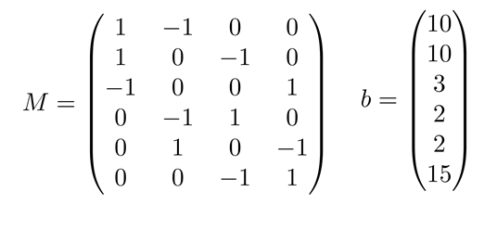
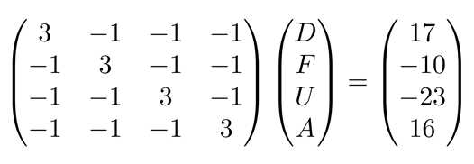
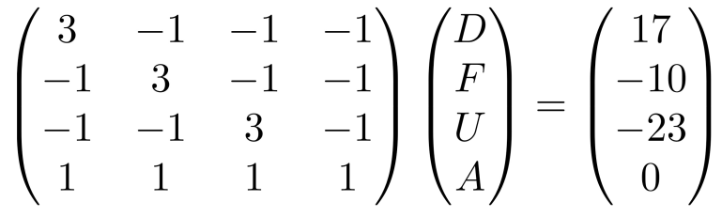
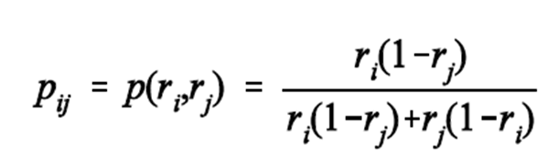
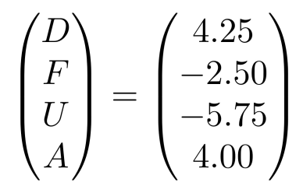
Advanced Methods – Massey Least Squares
Kenneth Massey created a ranking system for sports teams as an undergraduate thesis
Only the score, venue, and date of each game are used to calculate the Massey ratings
Vector of ratings will be a solution to the normal equations XTXr = XTy
E[Y] = ri - rj + xhrh

Slide 10
Advanced Methods - Kenpom
Ken Pomeroy is a writer and statistician that created an algorithm specifically to rank college basketball teams
He uses four factors main factors to rank offensive and defensive efficiency
Effective field goal percentage (eFG%): (FGM + 0.5*3PM) / FGA
Offensive rebounding percentage: OR / (OR + DR)
Turnover percentage: TO / Possessions
Free throw rate: FTA/FGA
Possessions = FGA-OR+TO+.475*FTA
The data is takes into account pace - the number of points scored or allowed per 100 possessions
It is then adjusted to estimate the offensive/defensive efficiency against an average DI team playing an average pace (adjO and ajdD)
“Pythagorean Winning Percentage” is calculated - expected winning percentage against an average D-I team.
Derived from (AdjO^10.25)/(AdjO^10.25+AdjD^10.25)

Slide 11

My Brackets
11.57 million brackets submitted in to ESPN
% = percentile among ESPN brackets
General Knowledge - 85.8%
Control (wp = .5 for each game) - 8.2%
Simple Seeding - 59.7%
Massey - 85.8% (most PPR)
Kenpom - 91.0%

Slide 12
In the Future
Use Python
Customized weighting
Ensemble Method - use multiple learning algorithms to obtain better predictive performance
Randomize predictions instead of simply advancing team with higher p value
Take into account if key players are missing
Use similar algorithms to focus on sports betting and fantasy sports

Slide 13
The End

